Slide 1
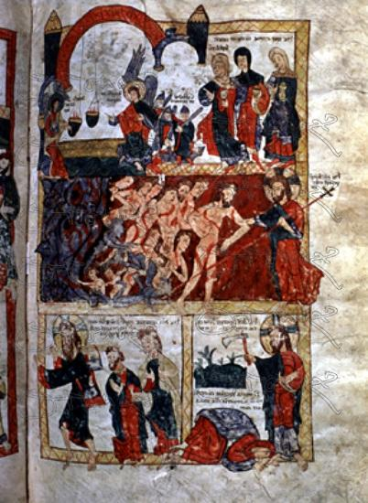
DATA ANALYSIS USING PYTHON Study on AVILA BIBLE
MANISHA PRIYADARSHINI RAWLA

Slide 2

THE AVILA DATASET
The Avila data set has been extracted from 800 images of the "Avila Bible", a giant Latin copy of the whole Bible produced during the XII century between Italy and Spain.
The paleographic analysis of the manuscript has individuated the presence of 12 copyists. The pages written by each copyist are not equally numerous.
Each pattern contains 10 features and corresponds to a group of 4 consecutive rows.
The prediction task consists in associating each pattern to one of the 12 copyists (labeled as: A, B, C, D, E, F, G, H, I, W, X, Y).
The data have has been normalized, by using the Z normalization method, and divided in two data sets: a training set containing 10430 samples, and a test set containing the 10437 samples.

Slide 3
DATA VISUALISATION

Slide 4
The different features are :
F1 : Inter columnar distance
F2: upper margin
F3 : lower margin
F4: exploitation
F5: row number
F6 : modular ratio
F7: interlinear spacing
F8 : weight
F9: peak number
F10 : modular ratio/interlinear spacing
As said earlier, this dataset is composed of 10 different features that each represent a particularity of a copyist.

Slide 5
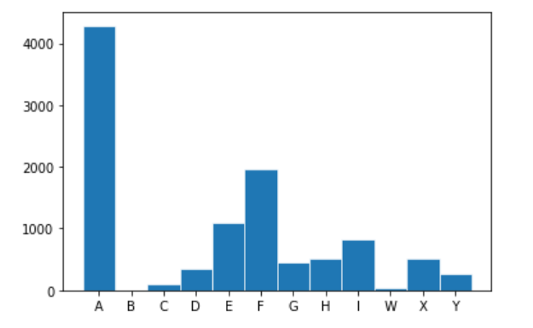
Composition of the training dataset
Distribution of samples by copyists

Slide 6
PCA AND LINK BETWEEN THE FEATURES

Slide 7
PCA makes maximum variability in the dataset more visible by rotating the axes. PCA identifies a list of the principal axes to describe the underlying dataset before ranking them according to the amount of variance captured by each.
Explained variance ratio of the first 10 components

Slide 8
On this dataset, nearly 80% of the total variance is explained only by using the 2nd components of the PCA.
Cumulative Explained variance ratio of the first 10 components

Slide 9
Correlation circle help us to visualize the correlations between the original dataset features. The principal components are shown via coordinates.
And this was predictable, because, for instance, F6 and F7 are representing the modular ratio and inter linear spacing of the copyist whereas F10 is a feature composed of the modular ratio over the inter linear spacing, so F10 is closely related to both features because it is directly composed by them.
The correlation circle shows that some features are very correlated like F10 and F6 or F7 and F6, but some aren't correlated at all like F10 and F2 or F4 and F3.

Slide 10
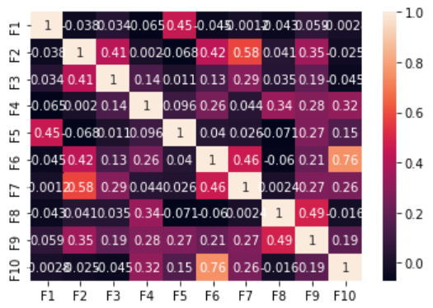
With the correlation matrix of the two datasets, earlier assumptions are now settled.
Correlation Matrix
F10, F6 and F7 are strongly correlated. But we
discover other surprising correlations like between
F5 and F1 which correspond to row number and
Inter columnar distance Or between F2 and F7 which
correspond to upper margin and interlinear spacing.

Slide 11
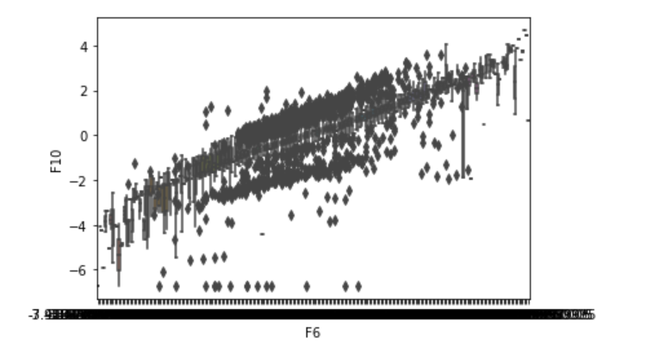
To illustrate the correlation between F6 and F10 we can use the following plots.
Seaborn plot of F10 correlation with F6
Plotly Express Scatter of the linear correlation between F6 and F10 features

Slide 12
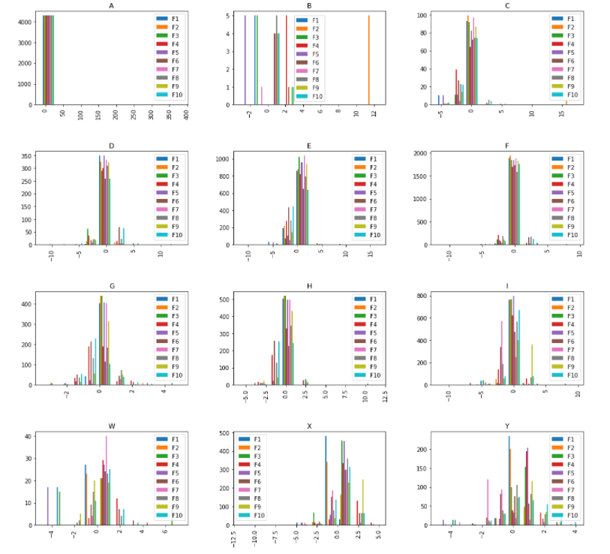
Here are the features distribution for each copyist.
We can see that some copyists have featured more and more normally scattered.
But some behave very unpredictably accordingly, these are the copyist with the least train samples (n.b. the histogram of 2 2 section).

Slide 13
PREDICTION

Slide 14
Data have already been Z normalized, learning algorithms can also benefit from scaling the data. 13 KNeighbors accuracy by number of neighbors• Thus, began prediction using multiple models.
Kneighbors accuracy by number of neighbors
KNeighbors gives roughly a 74% accuracy.
The most efficient hyperparameters with
GridSearch method where
(n_neighbors = 4, weights = "distance", metric=“euclidian“)

Slide 15
The most efficient hyperparameters with GridSearch method where (criterion='entropy', n_estimators=500, random_state=42)
RandomForest gives roughly a 98,02% accuracy.
Accuracy of RandomForest model by test/train ratio
We can see that the test/train ratio is stable even approaching the 70%. But we can also conclude that a ratio of 33% test/train gives us a pretty good accuracy, which is optimal for our case.

Slide 16
THANK YOU!

